Slide 1
Block Ciphers & Data Encryption Standard
Notes:
Lecture slides by Lawrie Brown for “Cryptography and Network Security”, 5/e, by William Stallings, Chapter 3 – “Block Ciphers and the Data Encryption Standard”.

Slide 2
Content
Block Cipher Principles
The Data Encryption Standard
Simplified-DES
DES Details
DES Design Issues and Attacks
3DES, AES and Other Block Ciphers

Slide 3
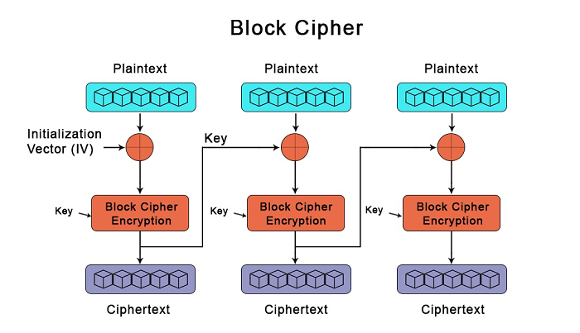
Block Ciphers
Encrypt data one block at a time
Used in broader range of applications
Typical block size 64 – 128 bits 128 bits
Most algorithms based on a structure referred to as Feistel block cipher
Notes:
Block ciphers work a on block / word at a time, which is some number of bits. All of these bits have to be available before the block can be processed. Stream ciphers work on a bit or byte of the message at a time, hence process it as a “stream”. Block ciphers are currently better analysed, and seem to have a broader range of applications, hence focus on them.

Slide 4
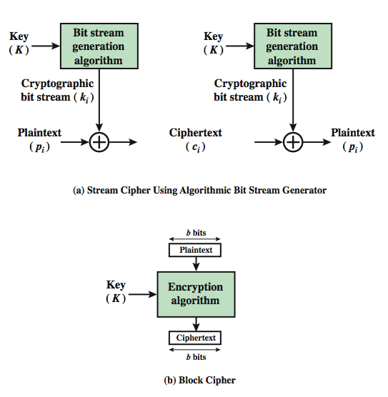
Block vs Stream Ciphers
Notes:
A block cipher is one in which a block of plaintext is treated as a whole and used to produce a ciphertext block of equal length. Typically, a block size of 64 or 128 bits is used. As with a stream cipher, the two users share a symmetric encryption key (Figure 3.1b). A stream cipher is one that encrypts a digital data stream one bit or one byte at a time. In the ideal case, a one-time pad version of the Vernam cipher would be used (Figure 2.7), in which the keystream (k ) is as long as the plaintext bit stream (p).

Slide 5
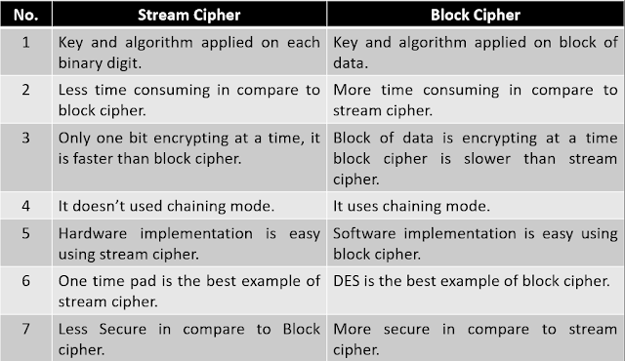
Block vs Stream Ciphers
Notes:
A block cipher is one in which a block of plaintext is treated as a whole and used to produce a ciphertext block of equal length. Typically, a block size of 64 or 128 bits is used. As with a stream cipher, the two users share a symmetric encryption key (Figure 3.1b). A stream cipher is one that encrypts a digital data stream one bit or one byte at a time. In the ideal case, a one-time pad version of the Vernam cipher would be used (Figure 2.7), in which the keystream (k ) is as long as the plaintext bit stream (p).

Slide 6
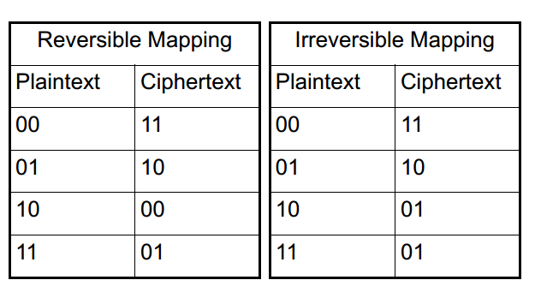
Block cipher principles
n-bit block cipher takes n bit plaintext and produces n bit ciphertext
2^{n} possible different plaintext blocks
Encryption must be reversible (decryption possible)
Each plaintext block must produce unique ciphertext block
Total transformations is 2^{n}!

Slide 7
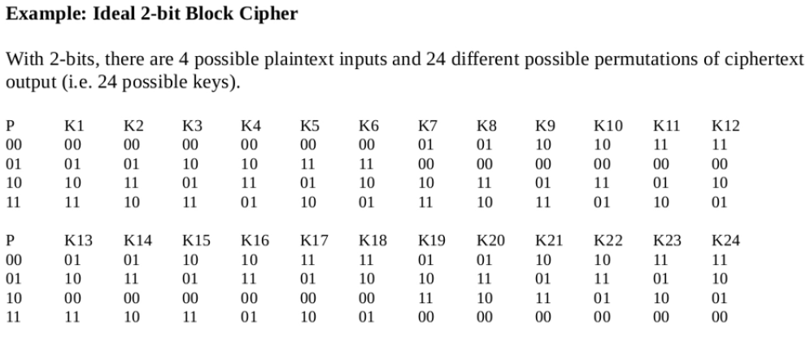
Ideal Block Cipher

Slide 8
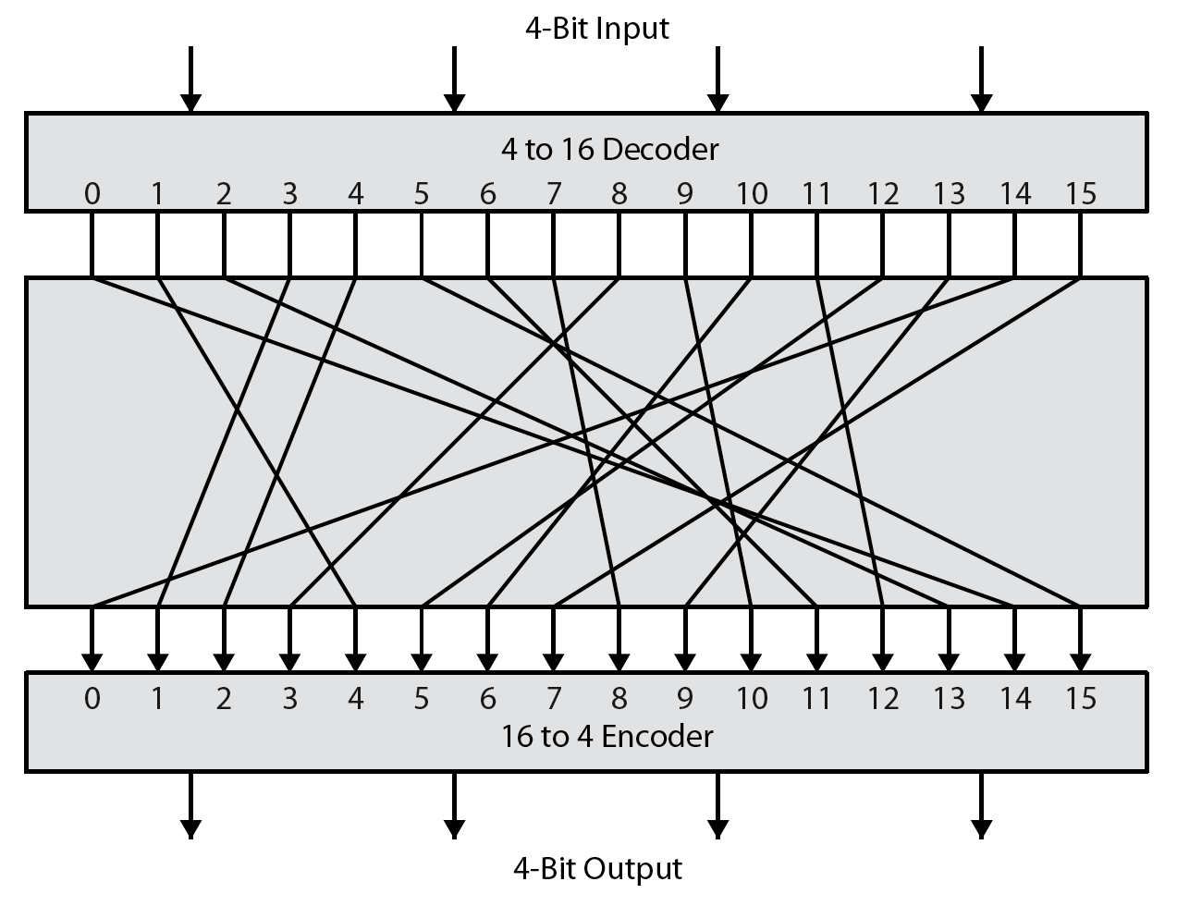
Ideal Block Cipher
key is mapping ; Key length 16 × 4 bits = 64 bits . i.e. concatenate all bits of ciphertext table
General
n-bit-n-bit Block
Substitution
(shown with n = 4)
Notes:
Feistel refers to an n-bit general substitution as an ideal block cipher, because it allows for the maximum number of possible encryption mappings from the plaintext to ciphertext block. A 4-bit input produces one of 16 possible input states, which is mapped by the substitution cipher into a unique one of 16 possible output states, each of which is represented by 4 ciphertext bits. The encryption and decryption mappings can be defined by a tabulation, as shown in Stallings Figure 3.2. It illustrates a tiny 4-bit substitution to show that each possible input can be arbitrarily mapped to any output - which is why its complexity grows so rapidly.

Slide 9
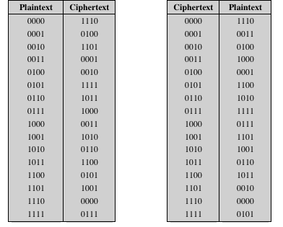
Encryption/decryption table

Slide 10
Ideal Block Cipher
n-bit input maps to 2^{n} possible input states
Substitution used to produce 2^{n} output states
Output states map to n-bit output
Ideal block cipher allows maximum number of possible encryption mappings from plaintext block
Problems with ideal block cipher:
Small block size: equivalent to classical substitution cipher; cryptanalysis based on statistical characteristics feasible
Large block size: key must be very large; performance/implementation problems
Key length :
In general, key length is 2^{n} × n
Actual block size is at least 64 (Key length will be 2⁶⁴× 64 ≈ 10²¹bits)
Notes:
Most symmetric block encryption algorithms in current use are based on a structure referred to as a Feistel block cipher. A block cipher operates on a plaintext block of n bits to produce a ciphertext block of n bits. An arbitrary reversible substitution cipher for a large block size is not practical, however, from an implementation and performance point of view. In general, for an n-bit general substitution block cipher, the size of the key is n x 2^{n}. For a 64-bit block, which is a desirable length to thwart statistical attacks, the key size is 64x 2⁶⁴ = 2⁷⁰ = 10²¹ bits. In considering these difficulties, Feistel points out that what is needed is an approximation to the ideal block cipher system for large n, built up out of components that are easily realizable.

Slide 11
Feistel Structure for Block Ciphers
Feistel proposed applying two or more simple ciphers in sequence so final result cryptographically stronger than component ciphers
n-bit block length; k-bit key length; 2^{k} transformations (rather than 2^{n} !)
Feistel cipher alternates: substitutions, transpositions (permutations)
Applies concepts of diffusion and confusion
Approach:
Plaintext split into halves
Subkeys (or round keys) generated from key
Round function, F, applied to right half
Apply substitution on left half using XOR
Apply permutation: interchange to halves
implements Shannon’s S-P net concept
Notes:
Feistel proposed that we can approximate the ideal block cipher by utilizing the concept of a product cipher, which is the execution of two or more simple ciphers in sequence in such a way that the final result or product is cryptographically stronger than any of the component ciphers. In particular, Feistel proposed the use of a cipher that alternates substitutions and permutations, as a practical application of a proposal by Claude Shannon. Claude Shannon’s 1949 paper has the key ideas that led to the development of modern block ciphers. Critically, it was the technique of layering groups of S-boxes separated by a larger P-box to form the S-P network, a complex form of a product cipher. He also introduced the ideas of confusion and diffusion, notionally provided by S-boxes and P-boxes (in conjunction with S-boxes).
Horst Feistel, working at IBM Thomas J Watson Research Labs devised a suitable invertible cipher structure in early 70's.
One of Feistel's main contributions was the invention of a suitable structure which adapted Shannon's S-P network in an easily inverted structure. It partitions input block into two halves which are processed through multiple rounds which perform a substitution on left data half, based on round function of right half & subkey, and then have permutation swapping halves. Essentially the same h/w or s/w is used for both encryption and decryption, with just a slight change in how the keys are used. One layer of S-boxes and the following P-box are used to form the round function.

Slide 12
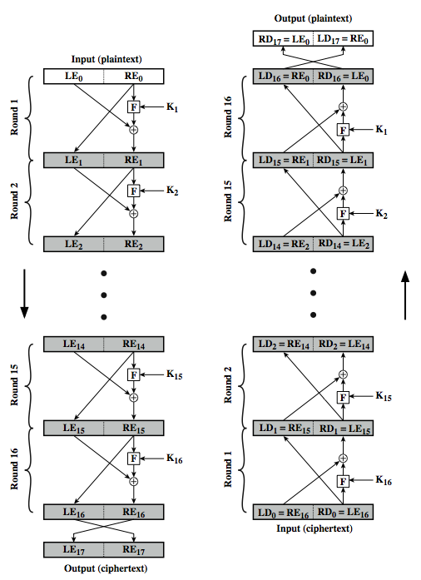
Feistel Cipher Structure
Encryption
https://www.youtube.com/watch?v=eEJaME0SEgI
Data split in 2 halves
processed through a number of rounds
Perform a substitution on left half using output of round function on right half & key
A permutation which swaps halves
Decryption
Notes:
Stallings Figure 3.3 illustrates the classical feistel cipher structure, with data split in 2 halves, processed through a number of rounds which perform a substitution on left half using output of round function on right half & key, and a permutation which swaps halves, as listed previously. The LHS side of this figure shows the flow during encryption, the RHS in decryption.
The inputs to the encryption algorithm are a plaintext block of length 2w bits and a key K. The plaintext block is divided into two halves, L₀ and R₀. The two halves of the data pass through n rounds of processing and then combine to produce the ciphertext block. Each round i has as inputs L_{i–1} and R_{i–1}, derived from the previous round, as well as a subkey K_{i}, derived from the overall K. In general, the subkeys K are different from K and from each other.
The process of decryption with a Feistel cipher is essentially the same as the encryption process. The rule is as follows: Use the ciphertext as input to the algorithm, but use the subkeys K_{i} in reverse order. That is, use K_{n} in the first round, K_{n–1} in the second round, and so on until K₁ is used in the last round. This is a nice feature because it means we need not implement two different algorithms, one for encryption and one for decryption. See discussion in text for why using the same algorithm with a reversed key order produces the correct result, noting that at every round, the intermediate value of the decryption process is equal to the corresponding value of the encryption process with the two halves of the value swapped.

Slide 13
Confusion and Diffusion
Diffusion
Statistical nature of plaintext is reduced in ciphertext
E.g. A plaintext letter affects the value of many ciphertext letters
How: repeatedly apply permutation (transposition) to data, and then apply function
Confusion
Make relationship between ciphertext and key as complex as possible
Even if attacker can find some statistical characteristics of ciphertext, still hard to find key
How: apply complex (non-linear) substitution algorithm
Notes:
The terms diffusion and confusion were introduced by Claude Shannon to capture the two basic building blocks for any cryptographic system. Shannon's concern was to thwart cryptanalysis based on statistical analysis. Every block cipher involves a transformation of a block of plaintext into a block of ciphertext, where the transformation depends on the key. The mechanism of diffusion seeks to make the statistical relationship between the plaintext and ciphertext as complex as possible in order to thwart attempts to deduce the key. Confusion seeks to make the relationship between the statistics of the ciphertext and the value of the encryption key as complex as possible, again to thwart attempts to discover the key.
So successful are diffusion and confusion in capturing the essence of the desired attributes of a block cipher that they have become the cornerstone of modern block cipher design.

Slide 14
Using the Feistel Structure
Exact implementation depends on various design features
Block size, e.g. 64, 128 bits: larger values leads to more diffusion
Key size, e.g. 128 bits: larger values leads to more confusion, resistance against brute force
Number of rounds, e.g. 16 rounds
Subkey generation algorithm: should be complex
Round function F: should be complex
Other factors include fast encryption in software and ease of analysis
Tradeoff : security vs performance
Notes:
The exact realization of a Feistel network depends on the choice of the following parameters and design features:
block size - increasing size improves security, but slows cipher
key size - increasing size improves security, makes exhaustive key searching harder, but may slow cipher
number of rounds - increasing number improves security, but slows cipher
subkey generation algorithm - greater complexity can make analysis harder, but slows cipher
round function - greater complexity can make analysis harder, but slows cipher
fast software en/decryption - more recent concern for practical use
ease of analysis - for easier validation & testing of strength

Slide 15
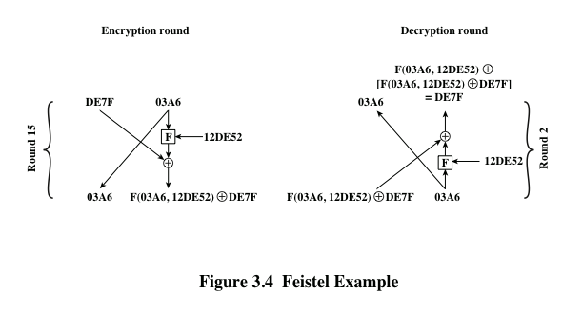
Feistel Example
Notes:
The process of decryption with a Feistel cipher
is essentially the same as the encryption process. The rule is as follows: Use the
ciphertext as input to the algorithm, but use the subkeys K_{i} in reverse order. That
is, use K_{n} in the first round, K_{n-1} in the second round, and so on, until K₁ is used in
the last round. This is a nice feature, because it means we need not implement two
different algorithms; one for encryption and one for decryption.

Slide 16
Data Encryption Standard (DES)
Symmetric block cipher
56-bit key, 64-bit input block, 64-bit output block
One of most used encryption systems in world
Developed in 1977 by NBS/NIST
Designed by IBM (Lucifer) with input from NSA
Principles used in other ciphers, e.g. 3DES, IDEA
Simplified DES (S-DES)
Cipher using principles of DES
Developed for education (not real world use)
Notes:
The most widely used private key block cipher, is the Data Encryption Standard (DES). It was adopted in 1977 by the National Bureau of Standards as Federal Information Processing Standard 46 (FIPS PUB 46). DES encrypts data in 64-bit blocks using a 56-bit key. The DES enjoys widespread use. It has also been the subject of much controversy its security.
In the late 1960s, IBM set up a research project in computer cryptography led by Horst Feistel. The project concluded in 1971 with the development of the LUCIFER algorithm. LUCIFER is a Feistel block cipher that operates on blocks of 64 bits, using a key size of 128 bits.
Because of the promising results produced by the LUCIFER project, IBM embarked on an effort, headed by Walter Tuchman and Carl Meyer, to develop a marketable commercial encryption product that ideally could be implemented on a single chip. It involved not only IBM researchers but also outside consultants and technical advice from NSA. The outcome of this effort was a refined version of LUCIFER that was more resistant to cryptanalysis but that had a reduced key size of 56 bits, to fit on a single chip.
In 1973, the National Bureau of Standards (NBS) issued a request for proposals for a national cipher standard. IBM submitted the modified LUCIFER. It was by far the best algorithm proposed and was adopted in 1977 as the Data Encryption Standard.

Slide 17
Simplified DES
Input (plaintext) block: 8-bits
Output (ciphertext) block: 8-bits
Key: 10-bits
Rounds: 2
Round keys generated using permutations and left shifts
Encryption: initial permutation, round function, switch halves
Decryption: Same as encryption, except round keys used in opposite order

Slide 18
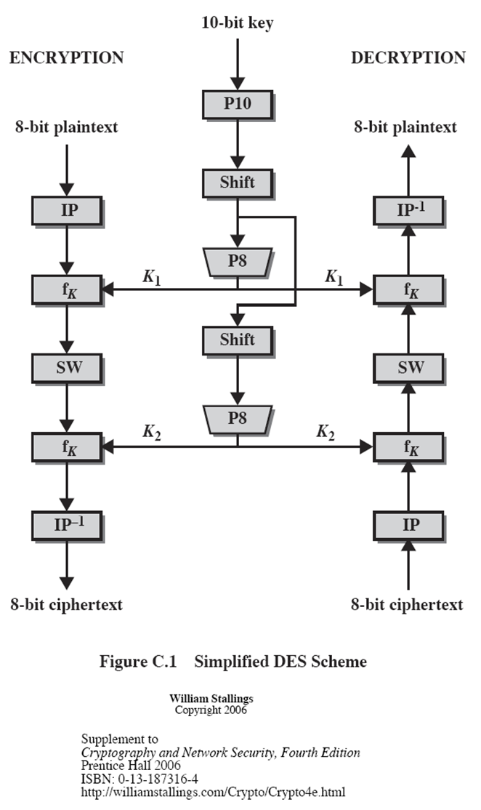
S-DES Algorithm
IP = { 2, 6, 3, 1, 4, 8, 5 , 7 }
IP -¹= { 4,1 ,3 ,5 ,7 ,2 ,8 , 6}

Slide 19
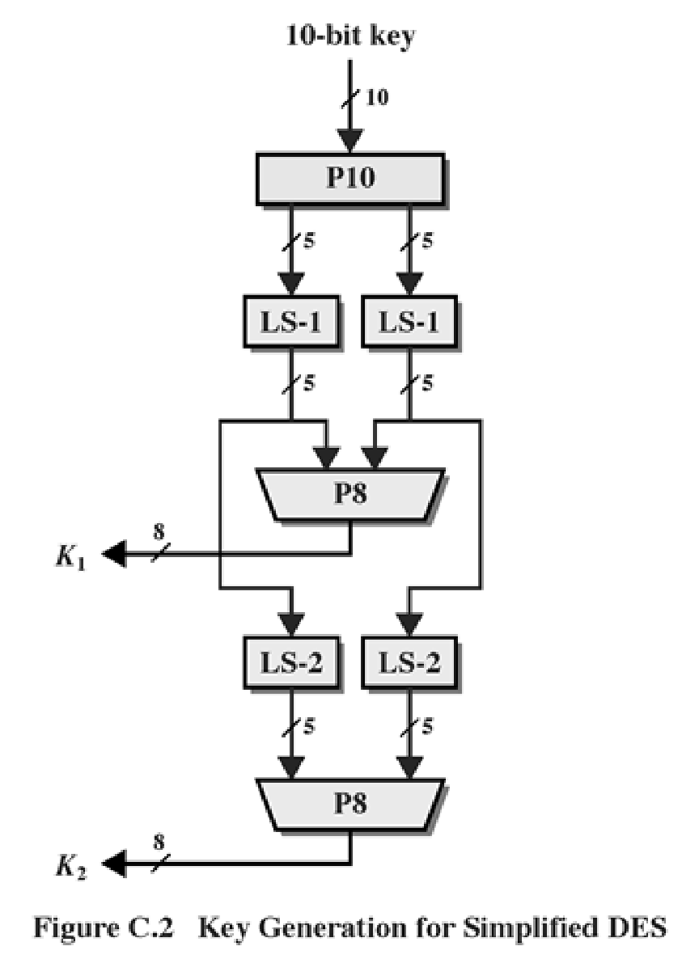
S-DES Key generation
P10 = { 3, 5, 2, 7, 4, 10, 1, 9, 8, 6}
Key: 10100 00010
P8 = { 6, 3, 7, 4, 8, 5, 10, 9}

Slide 20
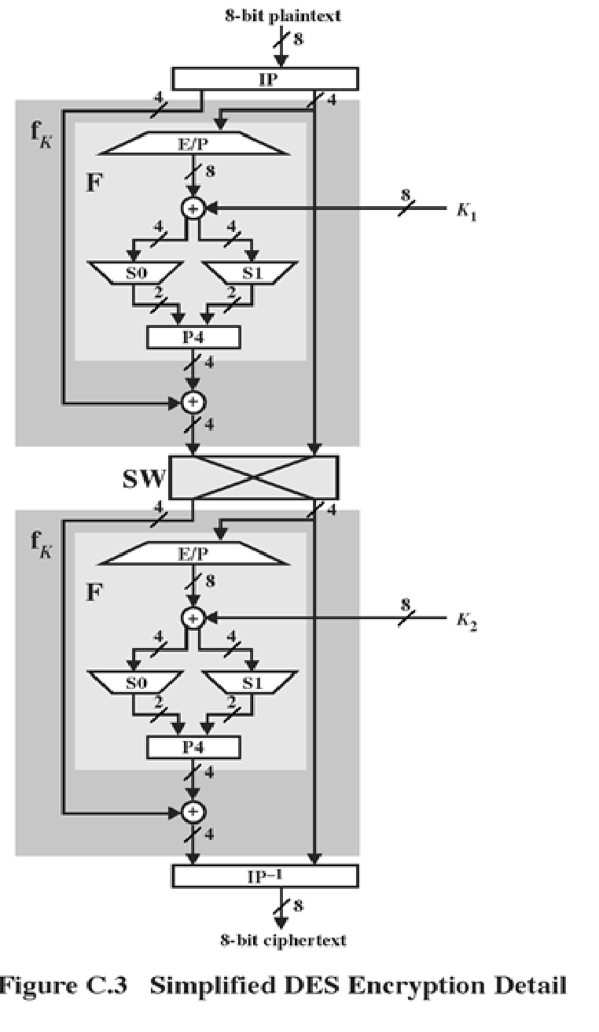

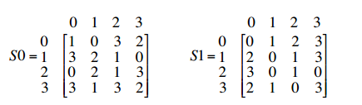
S-DES Encryption
IP = { 2.,6, 3 , 1 , 4 , 8 , 5 , 7 }
EP = { 4, 1, 2, 3, 2, 3, 4, 1}
K1 – 1010 0100
K2 – 0100 0011
P – 0111 0010
P4 = { 2, 4, 3, 1}
IP ⁻¹ = { 4.,1 ,3 , 5 , 7 , 2, 8 , 6}

Slide 21
S-Box
S-DES (and DES) perform substitutions using S-Boxes
S-Box considered as a matrix: input used to select row/column; selected element is output
4-bit input: bit1; bit2; bit3; bit4
bit1 , bit4 species row (0, 1, 2 or 3 in decimal)
bit2bit3 species column
2-bit output

Slide 22
S-DES Example
S-DES Example
Plaintext: 01110010
Key: 1010000010
Ciphertext: 01110111

Slide 23
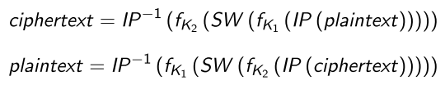
S-DES Summary
S-DES expressed as functions:
Security of S-DES:
10-bit key, 1024 keys: brute force easy
If know plaintext and corresponding ciphertext, can we determine key? Very hard

Slide 24
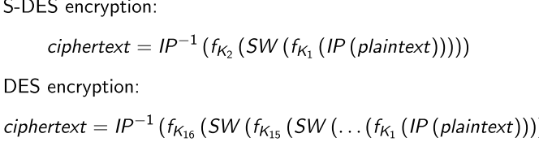
Comparing DES and S-DES
S-DES
8-bit blocks
10-bit key: 2 x 8-bit round keys
IP: 8-bits
F operates on 4 bits
2 S-Boxes
2 rounds
DES
64-bit blocks
56-bit key: 16 x 48-bit round keys
IP: 64 bits
F operates on 32 bits
8 S-Boxes
16 rounds

Slide 25
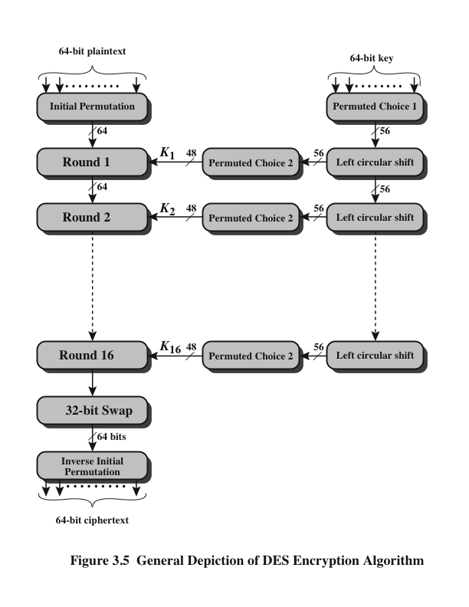
DES Encryption Algorithm
Notes:
The overall scheme for DES encryption is illustrated in Figure 3.5. As with any encryption
scheme, there are two inputs to the encryption function: the plaintext to be
encrypted and the key. In this case, the plaintext must be 64 bits in length and the
key is 56 bits in length.
Looking at the left-hand side of the figure, we can see that the processing
of the plaintext proceeds in three phases. First, the 64-bit plaintext passes through
an initial permutation (IP) that rearranges the bits to produce the permuted input .
This is followed by a phase consisting of sixteen rounds of the same function, which
involves both permutation and substitution functions. The output of the last (sixteenth)
round consists of 64 bits that are a function of the input plaintext and the
key. The left and right halves of the output are swapped to produce the preoutput .
Finally, the preoutput is passed through a permutation [IP ⁻¹ ] that is the inverse of
the initial permutation function, to produce the 64-bit ciphertext. With the exception
of the initial and final permutations, DES has the exact structure of a Feistel
cipher, as shown in Figure 3.3.
The right-hand portion of Figure 3.5 shows the way in which the 56-bit key is
used. Initially, the key is passed through a permutation function. Then, for each of
the sixteen rounds, a subkey (K_{i} ) is produced by the combination of a left circular
shift and a permutation. The permutation function is the same for each round, but a
different subkey is produced because of the repeated shifts of the key bits.
As with any Feistel cipher, decryption uses the same algorithm as encryption,
except that the application of the subkeys is reversed. Additionally, the initial and
final permutations are reversed.

Slide 26
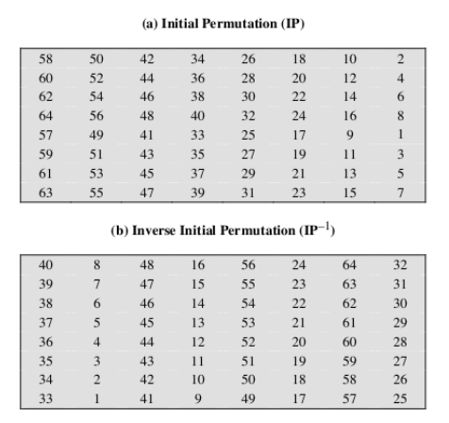
Permutation Tables for DES

Slide 27
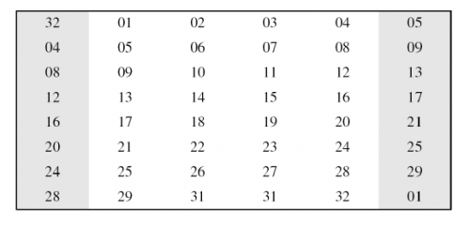
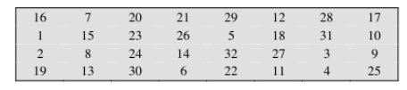
Permutation Tables for DES
3: Expansion permutation (E )
4 : Permutation Function (P)

Slide 28
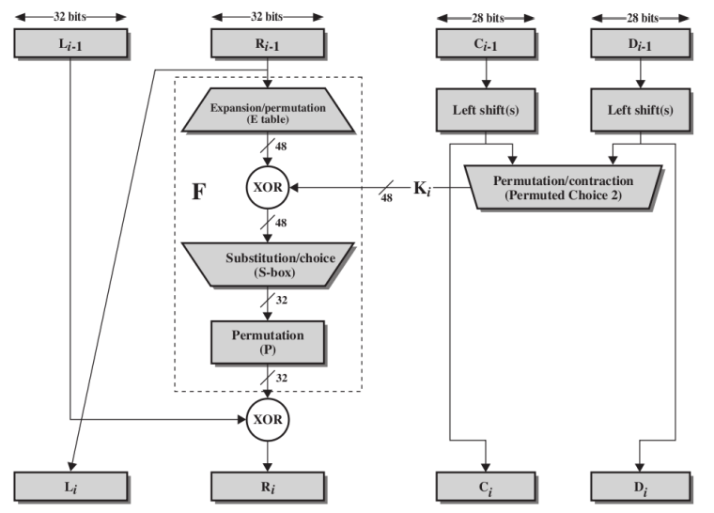
Single Round of DES Algorithm

Slide 29
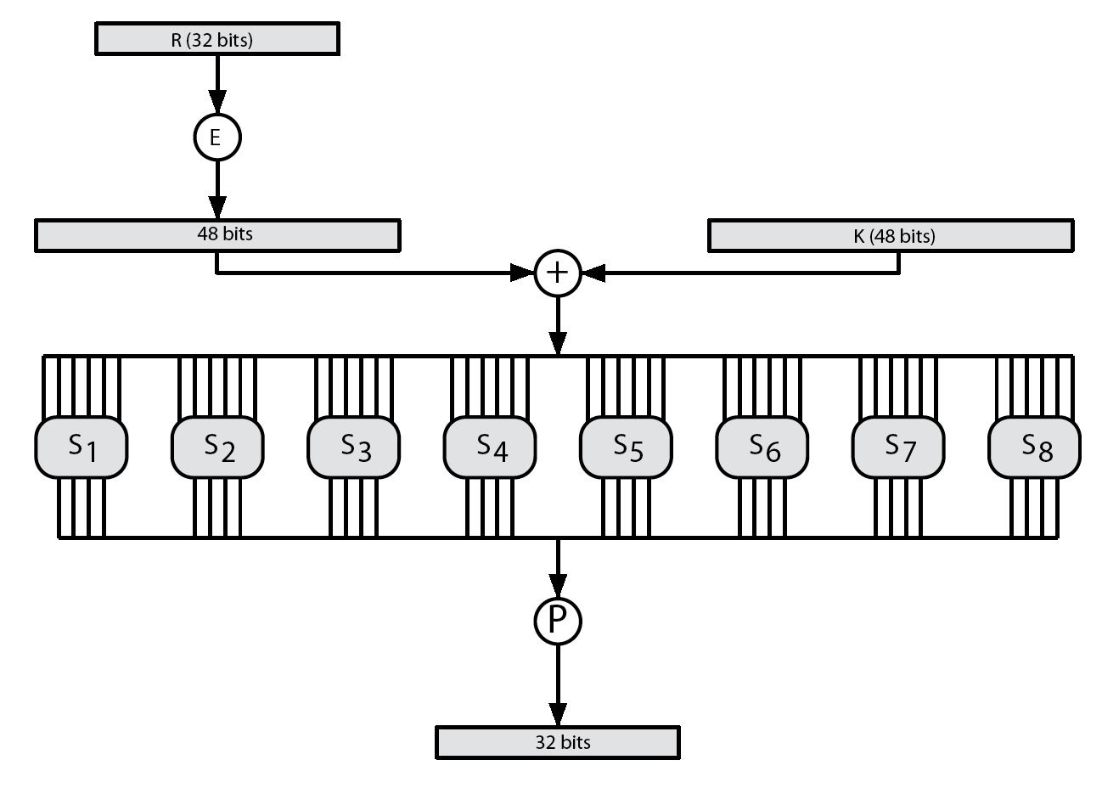
DES Round Structure
Notes:
Stallings Figure 3.7 illustrates the internal structure of the DES round function F. The R input is first expanded to 48 bits by using expansion table E that defines a permutation plus an expansion that involves duplication of 16 of the R bits (Stallings Table 3.2c). The resulting 48 bits are XORed with key K_{i} . This 48-bit result passes through a substitution function comprising 8 S-boxes which each map 6 input bits to 4 output bits, producing a 32-bit output, which is then permuted by permutation P as defined by Stallings Table 3.2d.

Slide 30
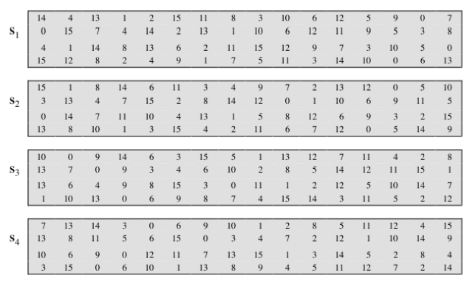
Definition of DES S-Boxes

Slide 31
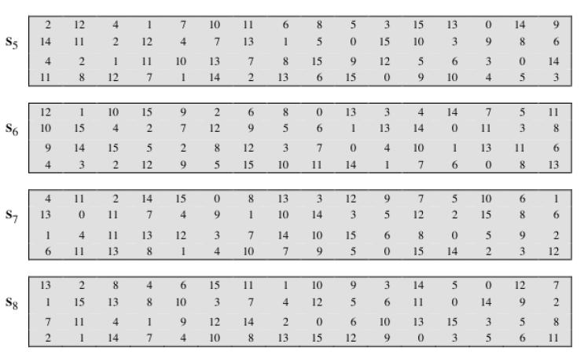
Definition of DES S-Boxes

Slide 32
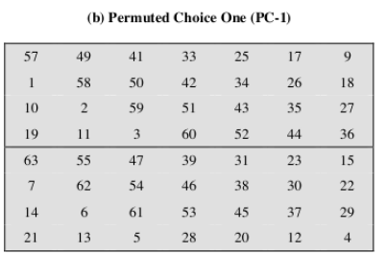
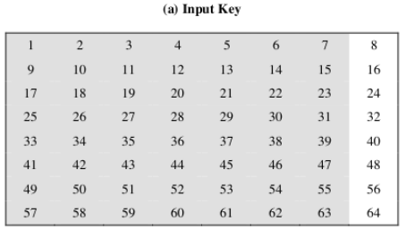
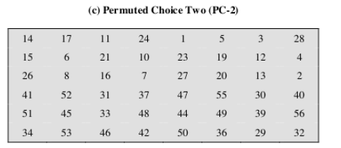
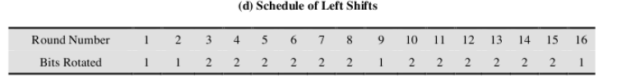
DES Key Schedule Calculation

Slide 33
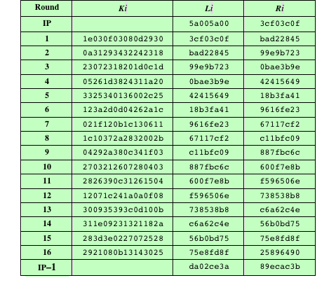
Table 3.2 DES Example
(Table can be found on page 75 in textbook)
Note: DES subkeys are shown as eight 6-bit values in hex format
Notes:
We now work through an example and consider some of its implications. Although
you are not expected to duplicate the example by hand, you will find it informative
to study the hex patterns that occur from one step to the next.
For this example, the plaintext is a hexadecimal palindrome. The plaintext,
key, and resulting ciphertext are as follows:
Plaintext: 02468aceeca86420
Key: 0f1571c947d9e859
Ciphertext: da02ce3a89ecac3b
Table 3.2 shows the progression of the algorithm. The first row shows the 32-bit
values of the left and right halves of data after the initial permutation. The next 16
rows show the results after each round. Also shown is the value of the 48-bit subkey
generated for each round. Note that L_{i} = R_{i-1} . The final row shows the left- and
right-hand values after the inverse initial permutation. These two values combined
form the ciphertext.

Slide 34
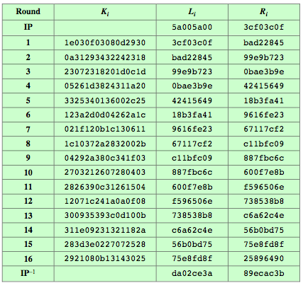
DES Example
Notes:
Can now work through an example, and consider some of its implications. In this example, the plaintext is a hexadecimal palindrome, with:
Plaintext: 02468aceeca86420
Key: 0f1571c947d9e859
Ciphertext: da02ce3a89ecac3b
Table 3.5 shows the progression of the algorithm. The first row shows the 32-bit values of the left and right halves of data after the initial permutation. The next 16 rows show the results after each round. Also shown is the value of the 48-bit subkey generated for each round. The final row shows the left and right-hand values after the inverse initial permutation. These two values combined form the ciphertext.

Slide 35
Avalanche Effect
Aim: small change in key (or plaintext) produces large change in ciphertext
Avalanche effect is present in DES (good for security)
Following examples show the number of bits that change in output when two different inputs are used, differing by 1 bit
Plaintext 1: 02468aceeca86420
Plaintext 2: 12468aceeca86420
Ciphertext diﬀerence: 32 bits
Key 1: 0f1571c947d9e859
Key 2: 1f1571c947d9e859
Ciphertext diﬀerence: 30
Notes:
A desirable property of any encryption algorithm is that a small change in either the plaintext or the key should produce a significant change in the ciphertext. In particular, a change in one bit of the plaintext or one bit of the key should produce a change in many bits of the ciphertext. If the change were small, this might provide a way to reduce the size of the plaintext or key space to be searched. DES exhibits a strong avalanche effect, as may be seen in Stallings Table 3.5.

Slide 36
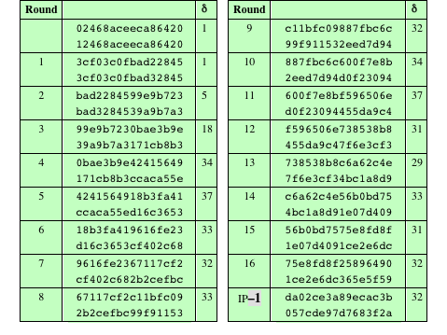
Table 3.3 Avalanche Effect in DES: Change in Plaintext
Notes:
A desirable property of any encryption algorithm is that a small change in either
the plaintext or the key should produce a significant change in the ciphertext. In
particular, a change in one bit of the plaintext or one bit of the key should produce
a change in many bits of the ciphertext. This is referred to as the avalanche effect. If
the change were small, this might provide a way to reduce the size of the plaintext
or key space to be searched.
Using the example from Table 3.2, Table 3.3 shows the result when the fourth
bit of the plaintext is changed, so that the plaintext is 12468aceeca86420 . The
second column of the table shows the intermediate 64-bit values at the end of each
round for the two plaintexts. The third column shows the number of bits that differ
between the two intermediate values. The table shows that, after just three rounds,
18 bits differ between the two blocks. On completion, the two ciphertexts differ in
32 bit positions.

Slide 37
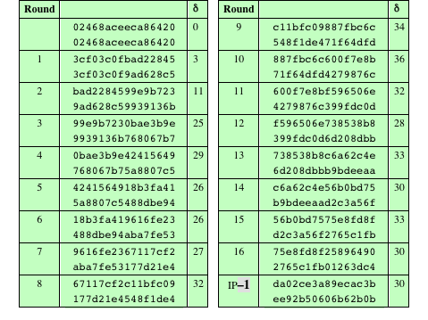
Table 3.4 Avalanche Effect in DES: Change in Key
Notes:
Table 3.4 shows a similar test using the original plaintext of with two keys that
differ in only the fourth bit position: the original key, 0f1571c947d9e859 , and
the altered key, 1f1571c947d9e859 . Again, the results show that about half of
the bits in the ciphertext differ and that the avalanche effect is pronounced after just
a few rounds.

Slide 38
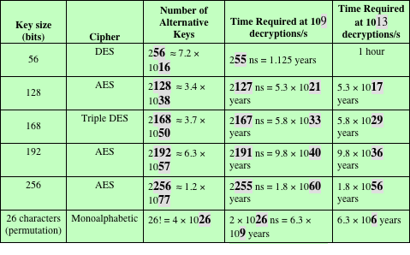
Average Time Required for Exhaustive Key Search
Notes:
Since its adoption as a federal standard, there have been lingering concerns about
the level of security provided by DES. These concerns, by and large, fall into two
areas: key size and the nature of the algorithm.
With a key length of 56 bits, there are 2⁵⁶ possible keys, which is approximately
7.2 * 10¹⁶ keys. Thus, on the face of it, a brute-force attack appears impractical.
Assuming that, on average, half the key space has to be searched, a single machine
performing one DES encryption per microsecond would take more than a thousand
years to break the cipher.
However, the assumption of one encryption per microsecond is overly conservative.
As far back as 1977, Diffie and Hellman postulated that the technology
existed to build a parallel machine with 1 million encryption devices, each of which
could perform one encryption per microsecond [DIFF77]. This would bring the
average search time down to about 10 hours. The authors estimated that the cost
would be about $20 million in 1977 dollars.
With current technology, it is not even necessary to use special, purpose-built
hardware. Rather, the speed of commercial, off-the-shelf processors threaten the
security of DES. A recent paper from Seagate Technology [SEAG08] suggests that
a rate of 1 billion (10⁹ ) key combinations per second is reasonable for today’s multicore
computers. Recent offerings confirm this. Both Intel and AMD now offer
hardware-based instructions to accelerate the use of AES. Tests run on a contemporary
multicore Intel machine resulted in an encryption rate of about half a billion
encryptions per second [BASU12]. Another recent analysis suggests that with
contemporary supercomputer technology, a rate of 10¹³ encryptions per second is
reasonable [AROR12].
With these results in mind, Table 3.5 shows how much time is required for
a brute-force attack for various key sizes. As can be seen, a single PC can break
DES in about a year; if multiple PCs work in parallel, the time is drastically shortened.
And today’s supercomputers should be able to find a key in about an hour.
Key sizes of 128 bits or greater are effectively unbreakable using simply a brute-force
approach. Even if we managed to speed up the attacking system by a factor
of 1 trillion (10¹² ), it would still take over 100,000 years to break a code using a
128-bit key.
Fortunately, there are a number of alternatives to DES, the most important of
which are AES and triple DES, discussed in Chapters 5 and 6, respectively.

Slide 39
Key size
Although 64 bit initial key, only 56 bits used in encryption (other 8 for parity check)
2⁵⁶ = 7.2 x 10¹⁶
1977: estimated cost $US20m to build machine to break in 10 hours
1998: EFF built machine for $US250k to break in 3 days
Today: 56 bits considered too short to withstand brute force attack
3DES uses 128-bit keys

Slide 40
Attacks on DES
Timing Attacks
Information gained about key/plaintext by observing how long implementation takes to decrypt
No known useful attacks on DES
Differential Cryptanalysis
Observe how pairs of plaintext blocks evolve
Break DES in 2⁴⁷ encryptions (compared to 255); but require 2⁴⁷ chosen plaintexts
Linear Cryptanalysis
Find linear approximations of the transformations
Break DES using 2⁴³ known plaintexts

Slide 41
DES Algorithm Design
DES was designed in private; questions about the motivation of the design
S-Boxes provide non-linearity: important part of DES, generally considered to be secure
S-Boxes provide increased confusion
Permutation P chosen to increase diffusion

Slide 42
Multiple Encryption with DES
DES is vulnerable to brute force attack
Alternative block cipher that makes use of DES software/equipment/knowledge: encrypt multiple times with different keys
Options:
1. Double DES: not much better than single DES
2. Triple DES (3DES) with 2 keys: brute force 2¹¹²
3. Triple DES with 3 keys: brute force 2¹⁶⁸

Slide 43
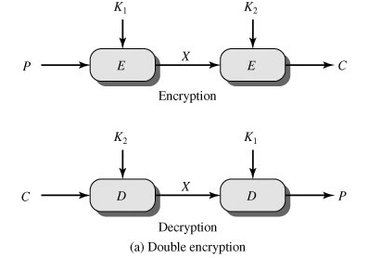
Double Encryption
For DES, 2 56-bit keys, meaning 112-bit key length
Requires 2¹¹¹ operations for brute force?
Meet-in-the-middle attack makes it easier

Slide 44
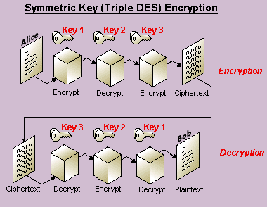
Triple Encryption
3 keys, 168 bits
Why E-D-E? To be compatible with single DES:

Slide 45
Summary
Block vs stream ciphers
Feistel cipher design & structure
DES
details
strength
Double DES
Triple DES
Notes:
Chapter 3 summary.

